Slide 1
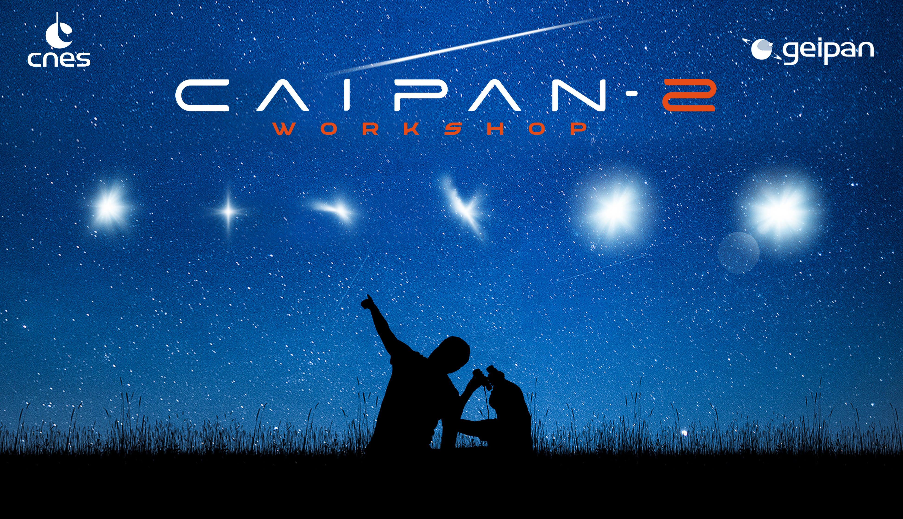
GEIPAN
a real case step by step investigation
Antoine COUSYN
GEIPAN investigator
  TOULOUSE,
  13 > 14 octobre 2022
Collecte et Analyse des Informations sur les Phénomènes Aérospatiaux Non identifiés

Slide 2
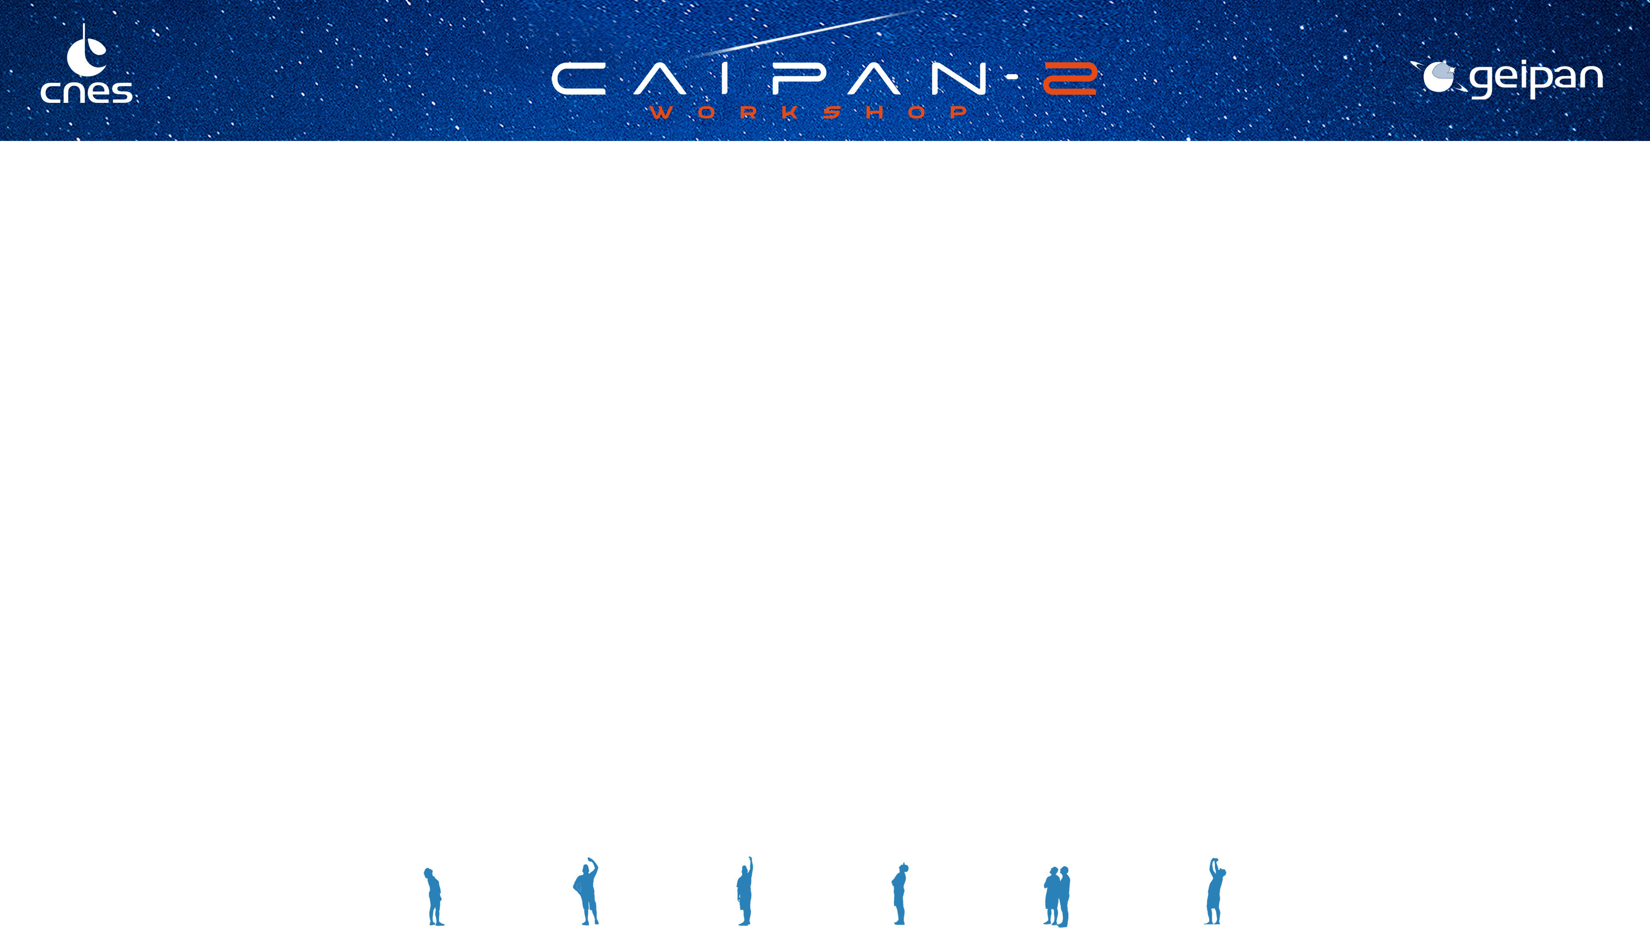







The witness : first contact
The case
The environment
On-site investigation
Hypotheses suggestions and evaluations part 1
Hypotheses suggestions and
evaluations part 2
Remote investigation
Antoine COUSYN
1

Slide 3
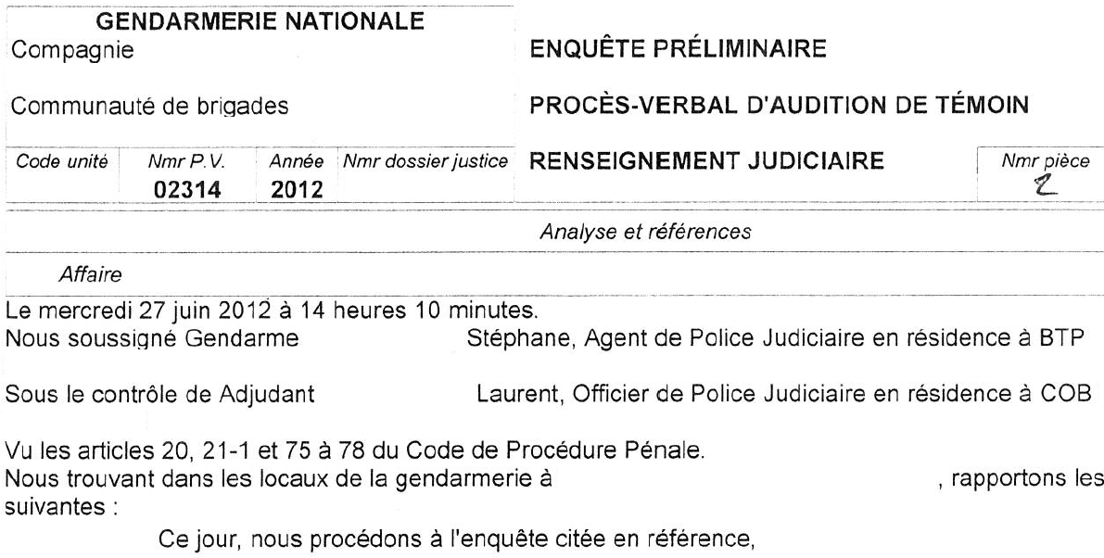
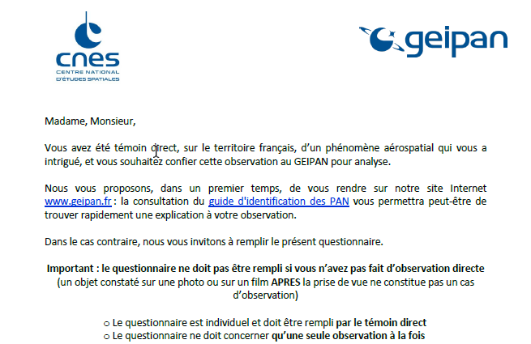
The witness : first contact
The witness has two main means of reporting their sighting, either directly through our dedicated web site and specific questionnaire
Or through the National Gendarmerie, linked by a specific partnership with the GEIPAN, renewed in 2011
In the exposed case today, the witness downloaded the questionnaire from the GEIPAN website and sent it to us by post
Antoine COUSYN
2

Slide 4
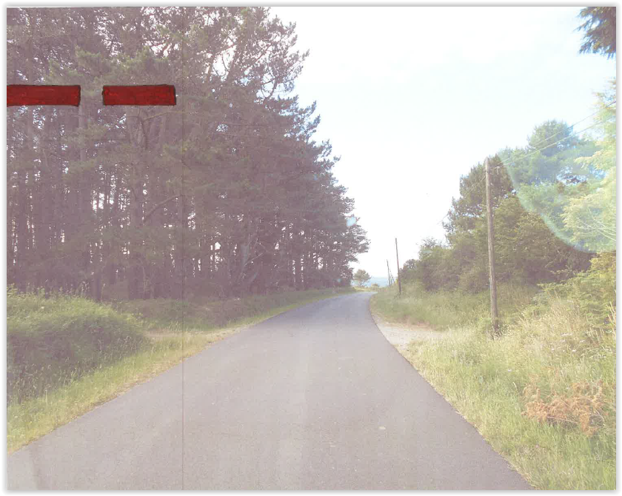
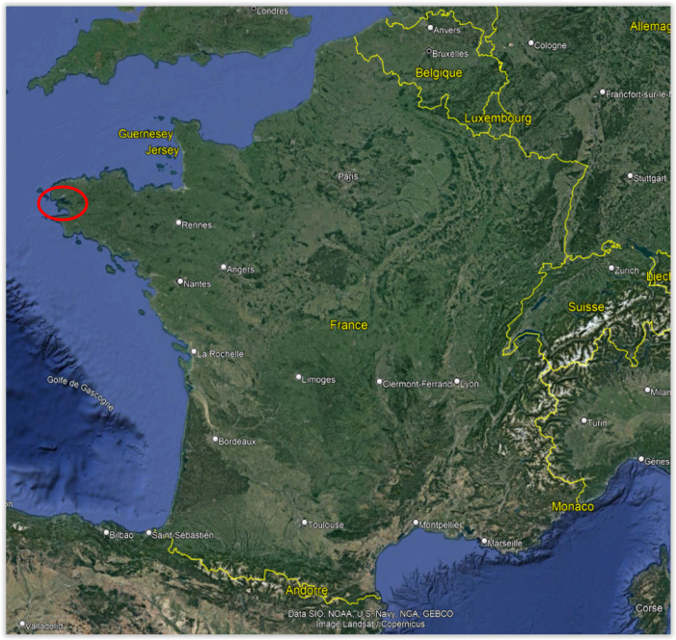
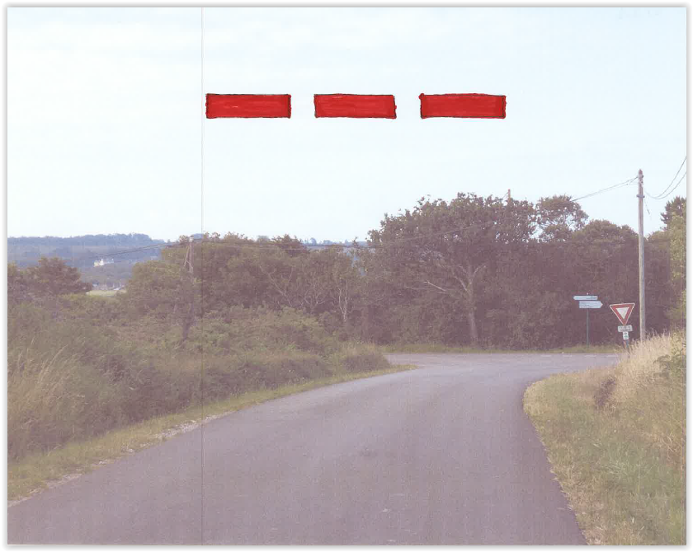
The “Crozon” case
The sighting occurred in Brittany province, west France, mid-January 2020, at 07:50AM
The witness is an army veteran who changed career to public transport. His mission is to collect children from secluded hamlets to bring them to school
While driving under bad weather conditions, he observed two red rectangles on the sky, partially hidden behind trees on the left of the road, approx. at 30° elevation and 140° azimuth
The witness slowed down while continuing to look at the UAP. A third similar rectangle appeared to the left of the others. The UAP’s moved alongside the road, maintaining the same configuration until it stopped in front of the witness
The witness also stopped and looked at the UAP for approx. 30s after which it began to slowly move away towards the horizon, adopting a strange behavior: rebounding like a flat stone on the surface of water until it finally disappeared
Antoine COUSYN
3

Slide 5
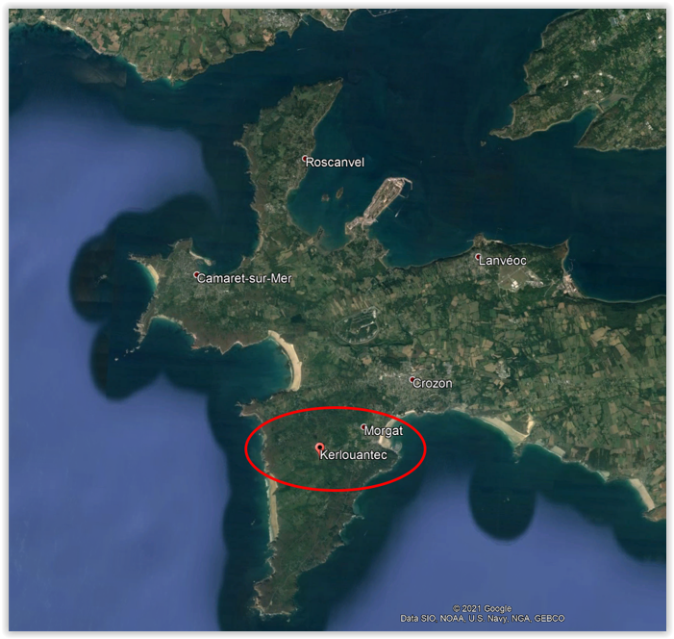
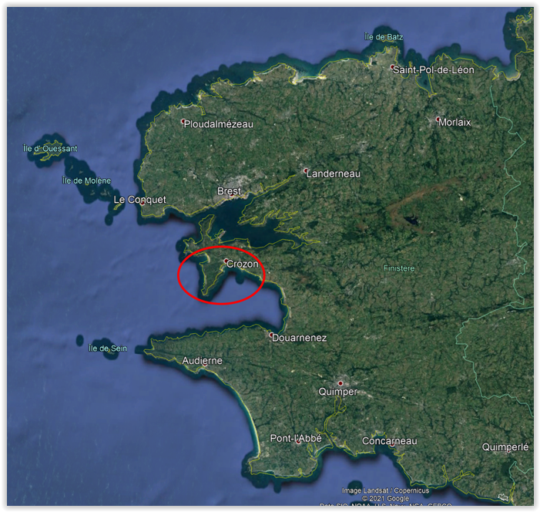
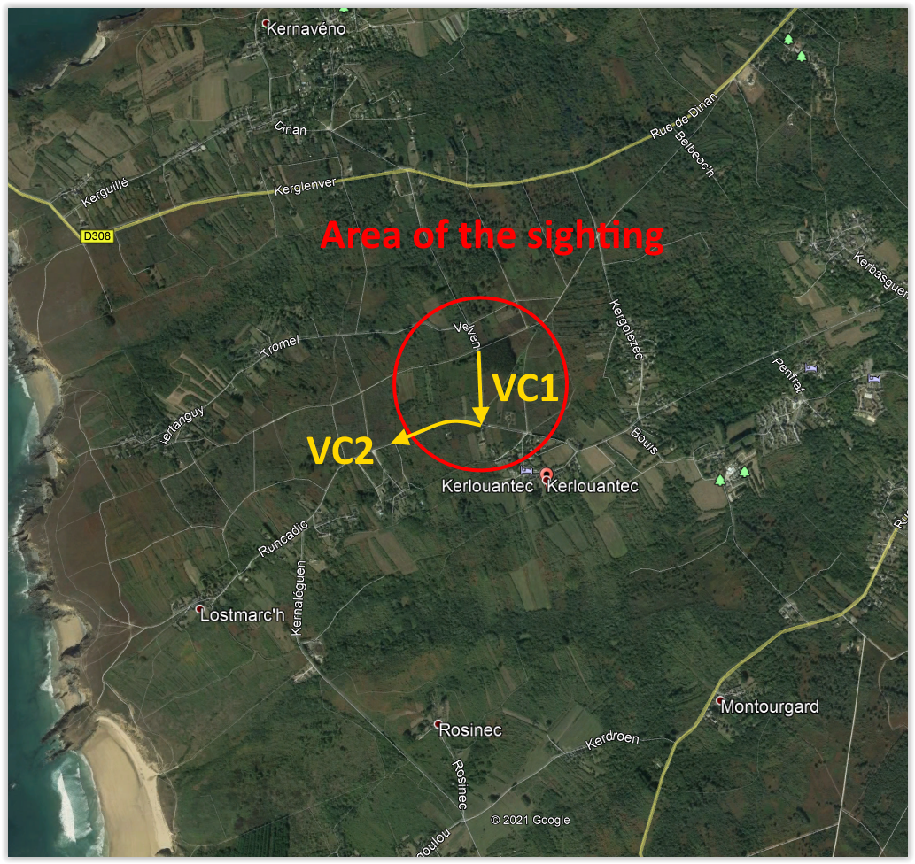
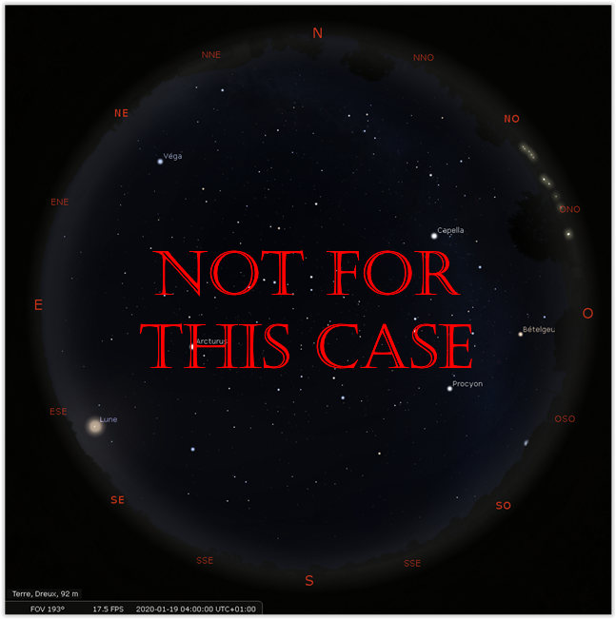

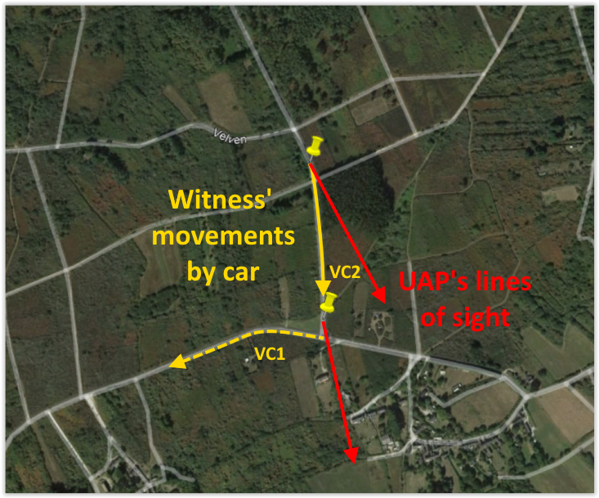
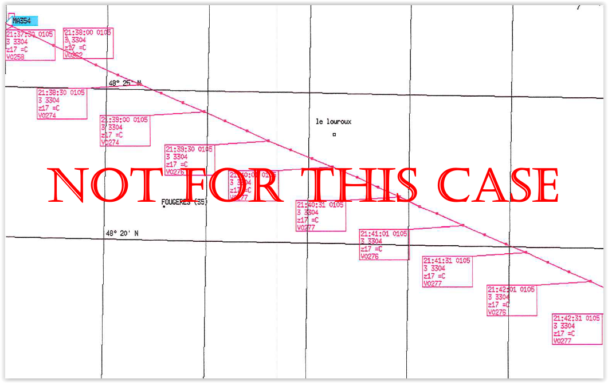
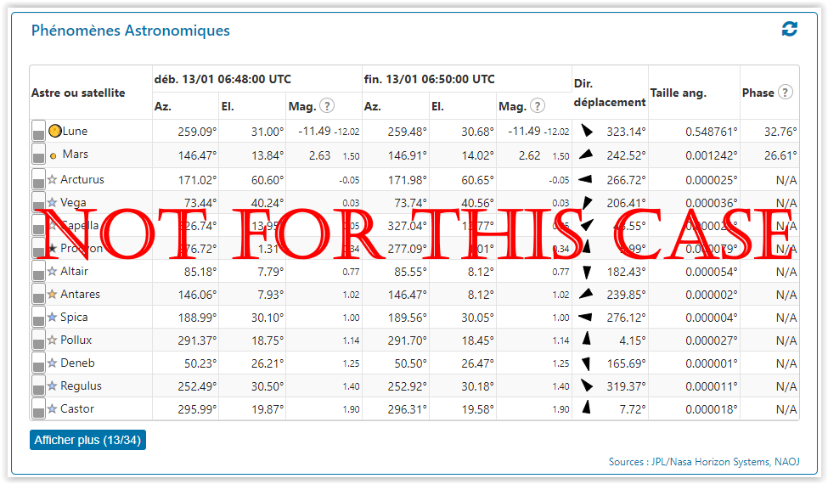
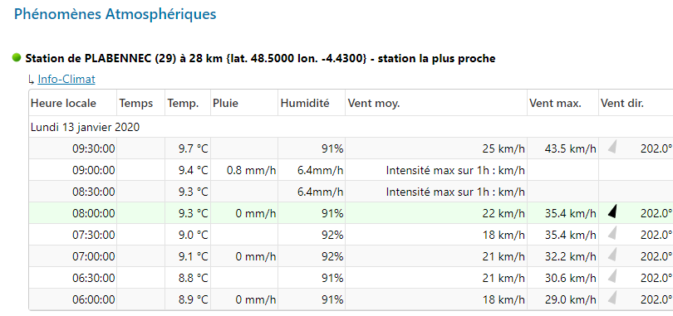
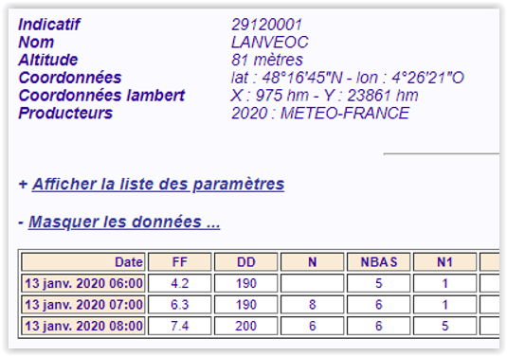
The preponderant role of the environment
The first step of the investigation is to acquire an accurate understanding of the environment at the time of the sighting and then master of the configuration:
Geographical, using Google Earth (used for the present case), French Géoportail... Mainly we place here witness(’s) position(s) and UAP’s line(s) of sight
Meteorological, using either Météo France data (with which the GEIPAN has an operating covenant) or GEIPAN’s base environment tool
Others situations can be exposed, depending of the context, such as astronomical (using Stellarium or GEIPAN’s base), astronautical with CNES’ COO* and aeronautical (mainly with radar’s data from CNOA**)
* COO : Operational Orbit determination Centre - ** CNOA : National Air Operations Centre
Antoine COUSYN
4

Slide 6
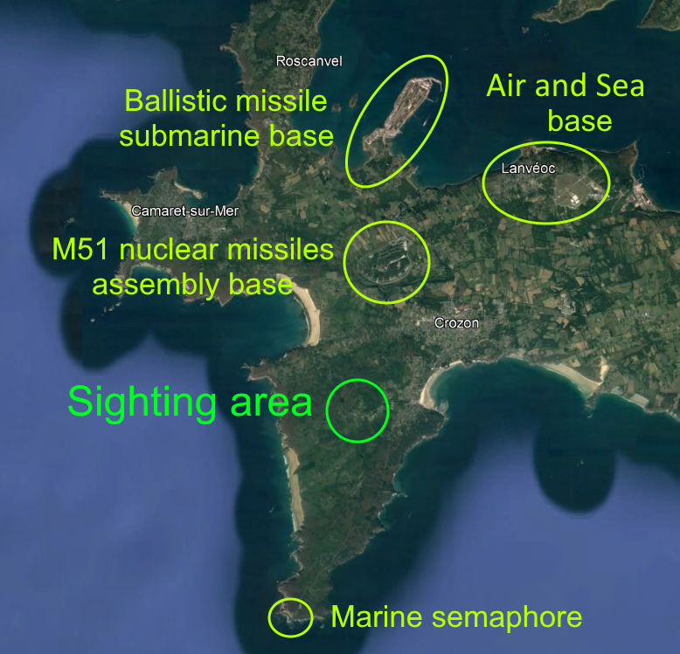
Remote investigation : a first search for clues
Every single detail extracted from the remote investigation has its importance in the hypotheses evaluation process (identification and analysis)
Environment:
geographical
meteorological…
Testimony:
UAP’s description,
sketches
→ A pervasive military environment
→ UAP’s appearance: three red rectangles with sharp edges
→ UAP’s behavior: moves toward the same direction as the witness
Clues
→ Bad weather: low clouds, heavy rain and gusts wind
Antoine COUSYN
5

Slide 7
On-site investigation : a second search for clues
Here as well, every single detail extracted from the field investigation also has its importance in the hypotheses evaluation process
(identification of new hypotheses and analysis/consolidation)
Witness’ cognitive interview
Measures:
UAP’s angular size, elevation, azimuth…
→ Very collaborative witness
→ Neither preconceptions nor beliefs detected
→ No inconsistencies between the interview and the testimony
→ New data has emerged
→ A huge angular size: 30° as its closest position
→ No inconsistencies between all the collected data in the ground measurements and the testimony
Clues
Antoine COUSYN
6

Slide 8
Hypotheses identification and evaluations part 1
The collected clues help to:
Evaluate strangeness
and consistency
High strangeness and good consistency
Elaborate hypotheses
Investigator’s first evaluation lead to no hypotheses
Then, more than two years after the sighting, the GEIPAN decided to discuss the case at the expert commission where some hypotheses are suggested, leading to further investigations:
Internal car light reflections on the windshield
Rejected: no similar lights inside the car
Rejected: UAP’s sharp edges and no
visible light beam with the rain
Lasers or spotlights reflections on the low clouds
Aeronautical object: plane, drone or helicopter
Semaphore/lighthouse lightings
Need more investigations (see part 2)
Antoine COUSYN
7

Slide 9
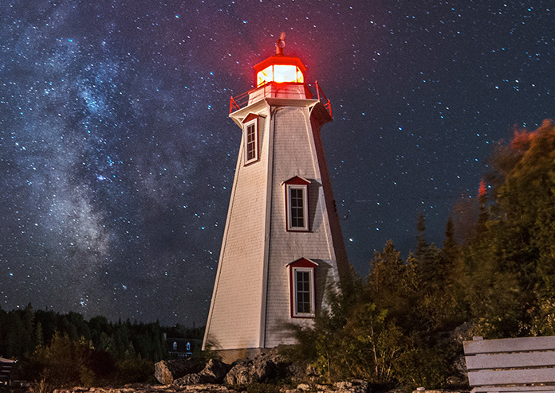
Hypotheses suggestions and evaluations part 2
Luminous phenomenon origin has been discussed a lot in the frame of the expert committee: planes, helicopters, drones or semaphore/lighthouse illumination
As the aeronautical hypothesis seemed to be the most plausible, it required further investigation, following two lines of investigation:
The investigator refined the aeronautical hypothesis:
Planes are eliminated due to the immobility of UAP
Concerning drone or helicopters, the angular size and number (3) of UAP components are questionable
?
GEIPAN contacted the closest French Air and Navy base (“BAN”)
No flights involving planes, helicopters or drones parked on the BAN were in progress at the time of the observation
No “special activity” was going on either
The semaphore/lighthouse
hypothesis is still under
investigation
Antoine COUSYN
8

Slide 10
Conclusion
An atypical environment:
  UAP’s sightings during bad weather aren’t common
  Lots of military facilities around the area sighting; the witness is himself a veteran
High consistency and strangeness:
  Credible, collaborative and reliable witness, no discrepancies between any of the components of the testimony – However, no photo or video of the UAP
  General appearance of the UAP barely resemble to the characteristics of known phenomenon
  Very odd particularities : little red marbles inside the rectangles and the way the UAP disappears
A full GEIPAN process:
  Remote and on-site investigation
  Expert committee analyzes and recommendations
  Fruitful interaction with the French Air and Navy
  GEIPAN evaluation and classification : to be finalized
“D1” (unexplained phenomenon) classification is proposed
Antoine COUSYN
9

Slide 11
Thank you for your attention !
Antoine COUSYN
10

